Slide 1


A
Mini Project Review - II
GESTURE CONTROL MOUSE
By:
Pratik Raj Harsh : 3224
Arnav Shiketode : 3236
Sumit Bhavsar : 3243
Guided By:
Prof. Supriya Dhoke
Department Of Electronics & Telecommunication
KJEI, Trinity Academy of Engineering, Pune.

Slide 2
CONTENTS
Introduction
Literature Survey
Objective
Specifications of proposed systems
Advantages
Applications & Future scope

Slide 3
INTRODUCTION
The Gesture Controlled Mouse is a system that allows users to control the computer cursor using hand gestures instead of a traditional mouse.
The system uses sensors such as MPU6050 and flex sensors connected to a NodeMCU (ESP8266) to detect hand movements and finger bending. The detected signals are processed and sent to the computer.
Using Python libraries like pyserial and pyautogui, the gestures are converted into mouse actions such as cursor movement, left click, and right click, enabling touchless human–computer interaction.

Slide 4
LITERATURE SURVEY
Sr. No. | Title of paper | Author Name | Year of Publication
1 | Design and Implementation of Gesture Controlled Mouse Using MPU6050 | A. Kumar, R. Sharma | 2020
2 | Wearable Gesture Recognition System for Human Computer Interaction | S. Patel, M. Shah, K. Mehta | 2019
3 | Hand Gesture Based Wireless Mouse Using Accelerometer and Gyroscope | P. Singh, T. Verma | 2021

Slide 5
OBJECTIVES
To design and develop a gesture-based mouse system that allows users to control a computer cursor using hand movements instead of a traditional mouse.
To integrate sensors and microcontroller, such as MPU6050, flex sensor, and NodeMCU (ESP8266), to detect and transmit hand gestures to the computer.
To implement gesture recognition using Python, converting sensor data into mouse actions like cursor movement and clicking using libraries such as pyserial and pyautogui.

Slide 6
Algorithm / Plan of implementation:
(Optional)
Interpret the gestures by analyzing the received sensor values.
Step 1: Start the system.
Step 2: Initialize the hardware components such as NodeMCU (ESP8266), MPU6050 sensor, and flex sensor.
Step 3: Establish serial communication between NodeMCU and the computer.
Step 4: Read sensor data from MPU6050 (accelerometer/gyroscope) and flex sensor continuously.
Step 5: Process the sensor values in the microcontroller and send the data to the computer through serial communication.
Step 6: Receive the sensor data in the Python program using the pyserial library.
Step 7: Interpret the gestures by analyzing the received sensor values.
Step 8: Convert the gestures into mouse actions such as cursor movement, left click, or right click using the pyautogui library.
Step 9: Execute the corresponding mouse operation on the computer screen.
Step 10: Repeat the process continuously until the system is stopped.
Step 11: End the program.

Slide 7
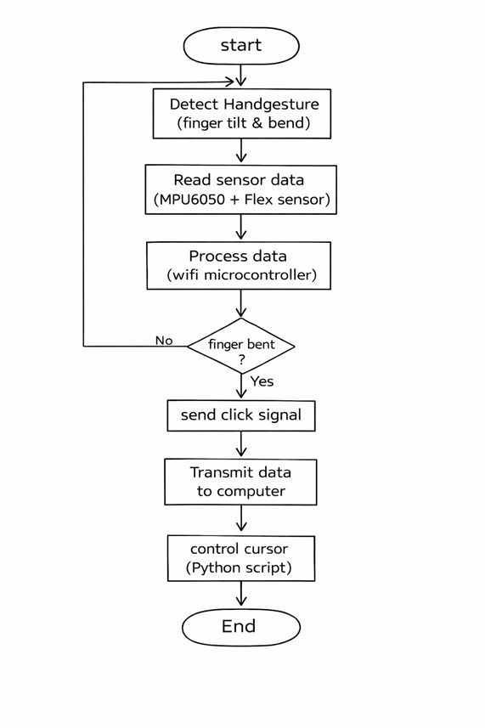
FLOW CHART (Optional)

Slide 8
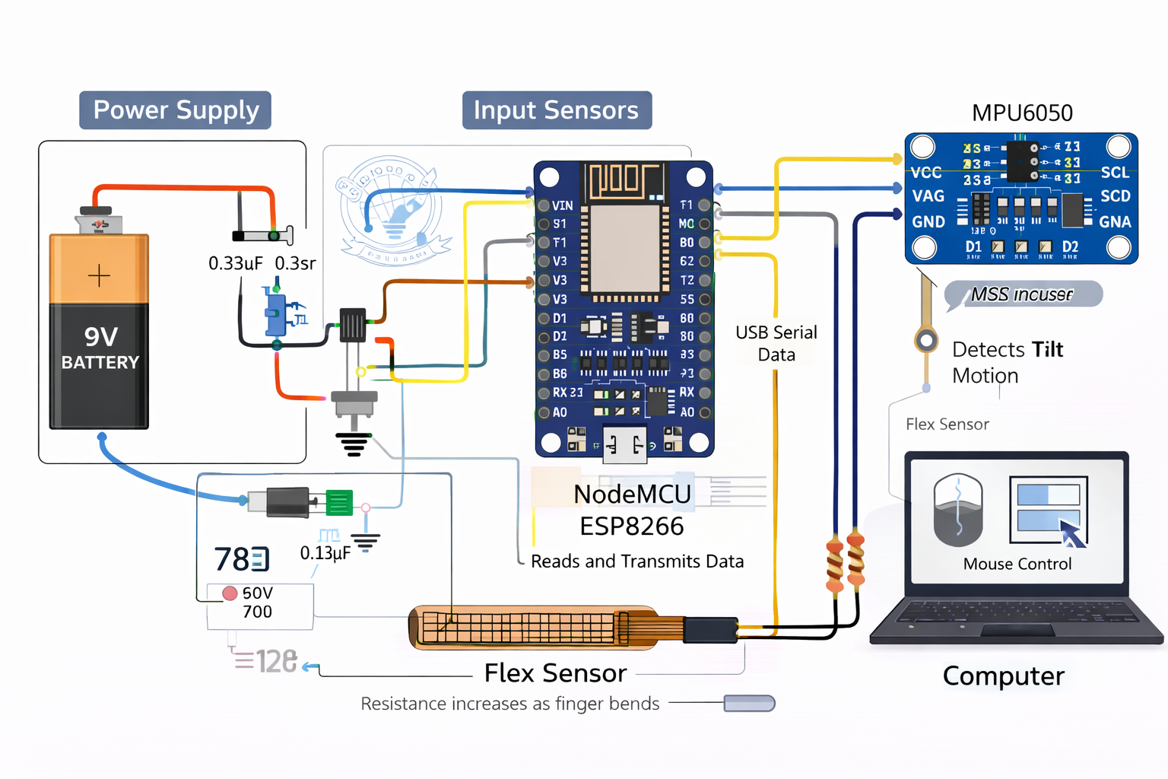
Circuit Diagram -

Slide 9
Specifications of Proposed system
The system uses an MPU6050 sensor to detect hand tilt and motion for cursor movement.
A flex sensor is used to detect finger bending for performing mouse click actions.
NodeMCU (ESP8266) processes the sensor data and controls the system.
Data is sent to the computer through USB serial communication or Wi-Fi.
A Python program converts the received data into mouse cursor movement and click commands.

Slide 10
ADVANTAGES
Low-cost system using affordable sensors.
Portable and wearable design.
Provides touchless computer control.
Compact and lightweight design.

Slide 11
APPLICATION
Smart classrooms – teachers can control presentations using hand gestures.
Gaming systems – gesture-based control for interactive games.

Slide 12
CONCLUSION
The Gesture Control Mouse system provides a touchless way to control a computer using hand gestures.
It uses MPU6050 motion sensor, flex sensor, and NodeMCU to detect hand movement and finger bending..
The system converts these gestures into cursor movement and mouse click actions using a Python program.
The project is low-cost, portable, and efficient.

Slide 13
FUTURE SCOPE
Improve accuracy and response time using better sensors.
Implement battery-powered wireless operation for full portability.

Slide 14
REFERENCES
[1]. A. Kumar and R. Sharma, “Design and Implementation of Gesture Controlled Mouse Using MPU6050,” International Journal of Engineering Research & Technology (IJERT), vol. 9, no. 5, pp. 123–126, 2020.
[2].S. Patel, M. Shah, and K. Mehta, “Wearable Gesture Recognition System for Human Computer Interaction,” IEEE International Conference on Smart Computing, pp. 45–50, 2019.
[3]. P. Singh and T. Verma, “Hand Gesture Based Wireless Mouse Using Accelerometer and Gyroscope,” International Journal of Innovative Research in Science and Engineering, vol. 7, no. 4, 2021.

Slide 15


